Slide 1
AETA products: Audio codecs

Slide 2
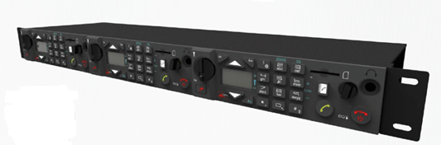
AETA codecs Overview
Product ranges : Rackmount codecs
SCOOP5 S
All networks in 1U
SCOOP5 S-IP
Only IP network, without front panel
SCOOPFONE HD-R
For cellular call GSM/HD Voice
SCOOPFONE 4G
For cellular call GSM/HD Voice
Codecs for all applications, contribution and distribution, studio or outside

Slide 3
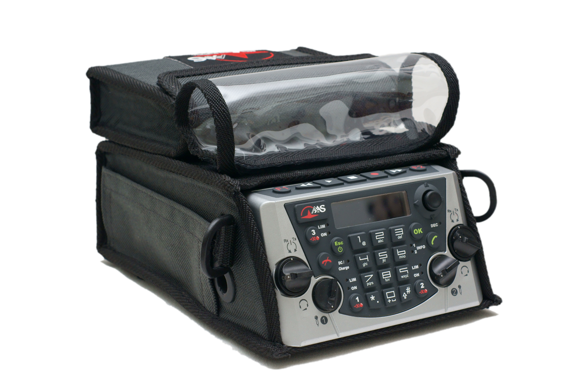
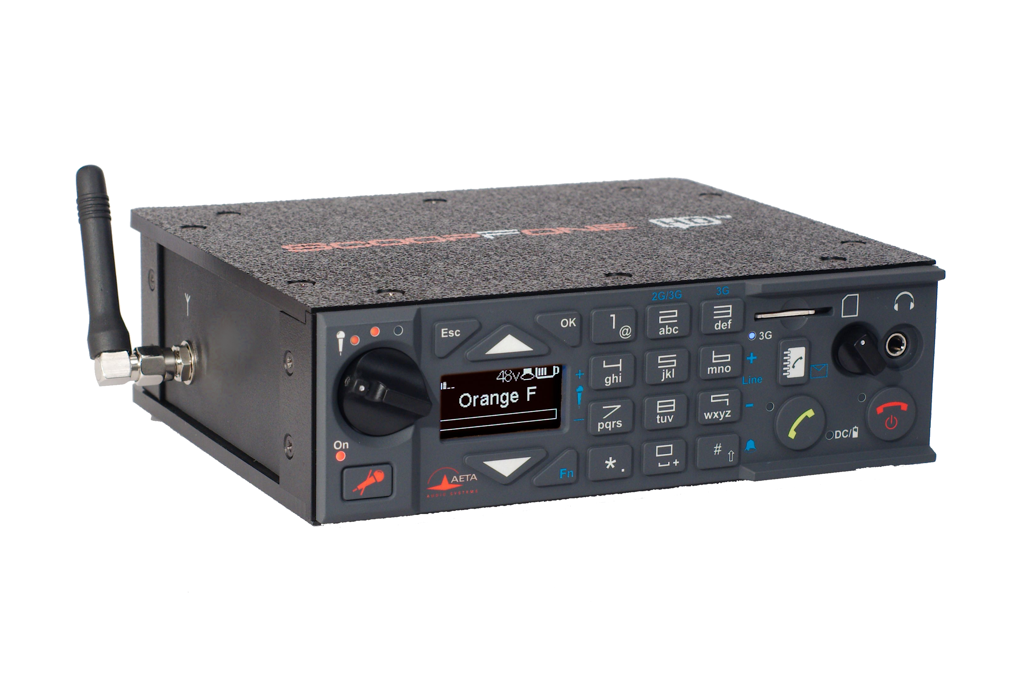
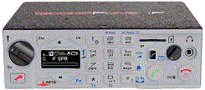
AETA codecs Overview
Product ranges : Portable codecs
SCOOPY+ S
Multi-network / 3 inputs / Stereo
SCOOPFONE HD
Cellular mode / 2 inputs / Mono
SCOOPFONE 4G
Cellular mode (Voice and data) /2 inputs / Mono
Codecs for all applications, contribution and distribution, studio or outside

Slide 4
AETA codecs Networks and coding algorithms
Codec | Wired |  |  | Wireless
 | POTS | ISDN | Ethernet | 3G+ LTE | EDGE UMTS | Voice
GSM, AMR
G711
AMR-WB
CELP
G722
4SB ADPCM
MPEG L2
MPEG AAC
OPUS
3 kHz
7 kHz
15 kHz
20 kHz
Codecs for all networks, wide range of algorithms

Slide 5
Rackmount codecs: Scoop 5 S
Main design features
Interfaces
Multi-network: X24/V11, Ethernet/IP, ISDN, POTS, Mobile
Multi-algorithm
Linux platform
1 RU size: compact, convenient for OB vans
Low consumption, no fan: quiet, reliable
12VDC power optional
Digital AES-EBU I/O as standard.
Balanced protected analog I/O
8 GPIO, including 2 opto-isolated
Auxiliary data channel
User interface: easy to use front panel access
Remotely controllable and monitorable: IP, RS232, HTML

Slide 6
Scoop 5 S Positioning
Positioning
ISDN and IP contribution
STL (Distribution or Studio to Transmitter Link): LL, IP
OB Vans: ISDN, IP, Wireless, POTS
Middle/High end
Safe platform for a wide range of applications

Slide 7
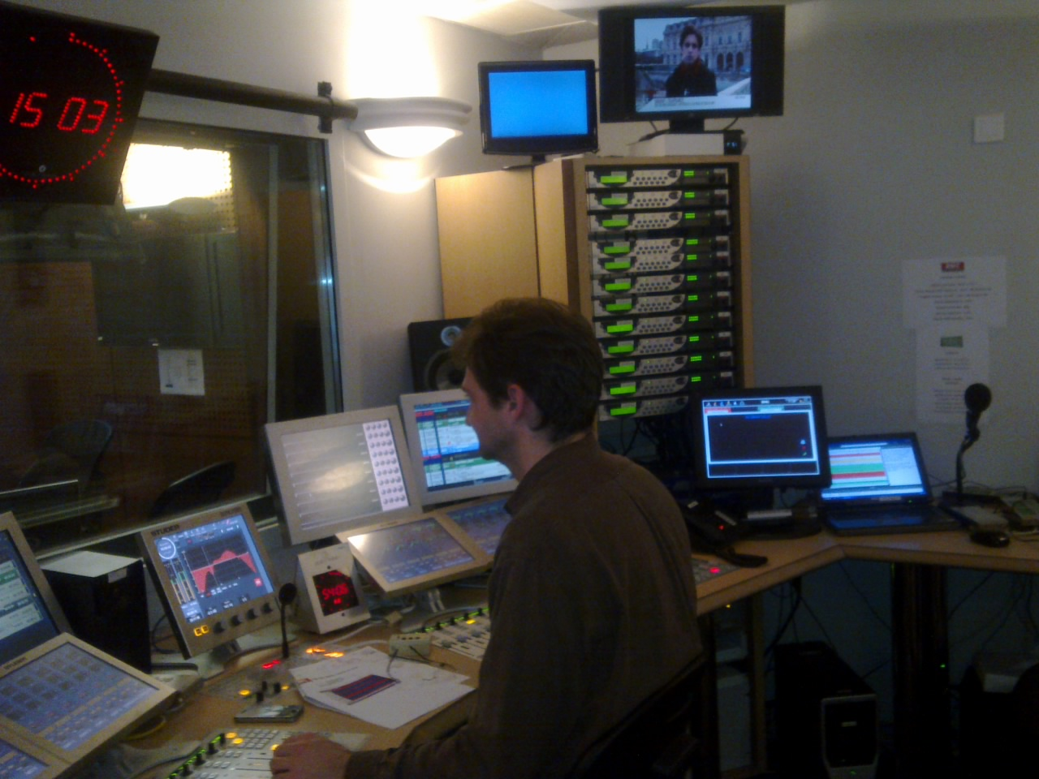
Scoop 5 S Positioning
RADIOS
Any live events :
News
Sports events
Street games
Interviews
…
Duplex communication with portable codecs on field
RMC Sport have 12 Scoop in each studio for multiplex sport events
Safe platform for a wide range of applications

Slide 8
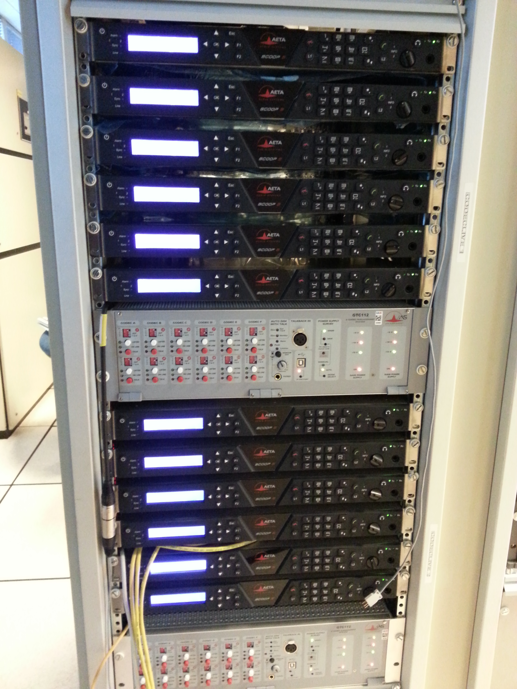
Scoop 5 S Positioning
TELEVISION
Technical coordination / Intercom for:
Live News
Sports events
Any big event (elections...)
Interviews
…
Complementary devices : Scoop Manager software + interface for coordination and monitoring GTC112
TV installation : Scoop 5 with GTC112
Safe platform for a wide range of applications

Slide 9
Scoop 5 S Some big features
Multi-network : IP / LL / ISDN / POTS / Wireless
Compact and low power => for OB vans
Reliable platform, telecom grade quality
High quality audio interfaces
5AS for ISDN
4SB ADPCM or MICDA 4SB : “Analog like” latency over ISDN
SIP compatible and compliant with EBU Tech 3326 (aka N/ACIP)
HD Voice

Slide 10
Rackmount codecs: Scoop 5 S-IP
Main design features
Interfaces
Network: Ethernet/IP only
Multi-algorithm
Linux platform
Low consumption, no fan: quiet, reliable
12VDC power optional
Digital AES-EBU I/O as standard.
Balanced protected analog I/O
8 GPIO, including 2 opto-isolated
Auxiliary data channel
Remotely controllable and monitorable: IP, RS232, HTML

Slide 11
Portable codecs: Scoopy+ S range
Applications
News remotes
Live sport commentaries with local contributors
Remote two-way interviews
Remote contributions into studio discussions
Live music concerts
"4 wheel drive" codec for every field situation

Slide 12
Scoopy+ S Network and audio interfaces
Network
Audio
IP/Ethernet
ISDN: up to 20 kHz (optional)
POTS: 7 kHz speech (optional)
Wireless (optional)
GSM / 3G / 3G+ / LTE
Integrated module and antenna
USB
Voice, standard or HD Voice
Data/IP : PS mode
Inmarsat BGAN (optional)
Integrated high performance mixer
3 Microphone / Line Inputs
2 Headphone Outputs
2 Line Outputs
HP filters, limiters
Mono or stereo operation
Recording on SD Card
USB interface
Most flexible portable codec on the market

Slide 13
Scoopy+ S Versions and options
Networks
IP on standard
ISDN 2B (Optional)
POTS (Optional)
Mobile HD Voice-4G (Optional)
Inmarsat BGAN remote (Optional)
Additional features
Recording : On SD Card, mono or stereo + Basic editing (Optional)

Slide 14
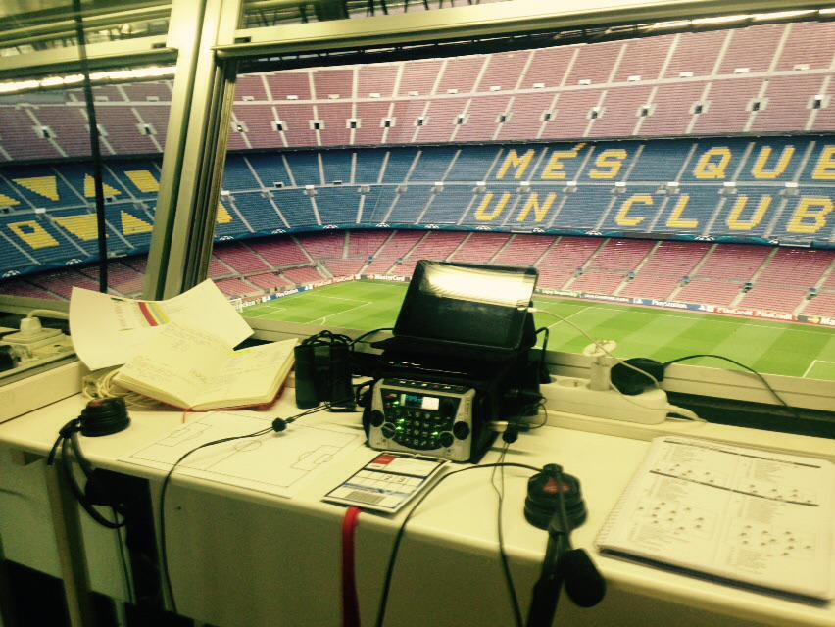
Scoopy+ S Positioning
Positioning
“Swiss –knife” portable codec
Portable and autonomous unit
Middle - High end market
Most portable and flexible codec on the market, recognized reference

Slide 15
Scoopy+ S Some big features
Highly integrated, light and autonomous unit : really portable
High performance audio interfaces
Friendly user interface
Powerful embedded html server
4SB ADPCM: "analog like" latency over ISDN
5AS for ISDN
SIP compatible and compliant with EBU Tech 3326 (aka N/ACIP)
Recording features
Integrated wireless GSM/3G/UMTS/EDGE
HD Voice
Voice mode can also be used for coordination

Slide 16
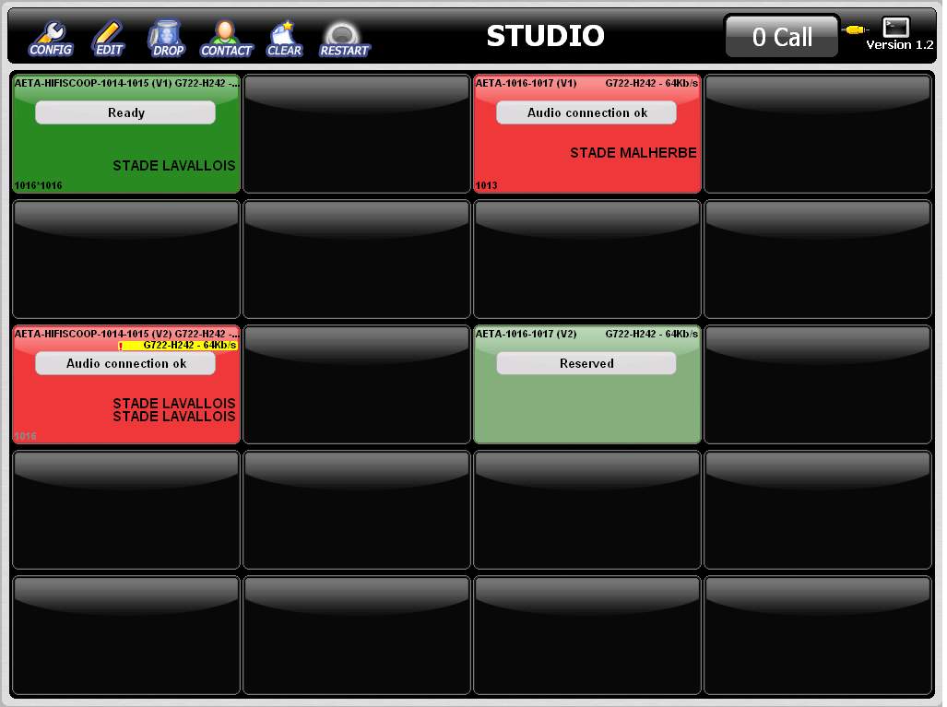
AETA Codecs Control systems
Scoop Manager
Codec pool management
Flexible and very ergonomic

Slide 17
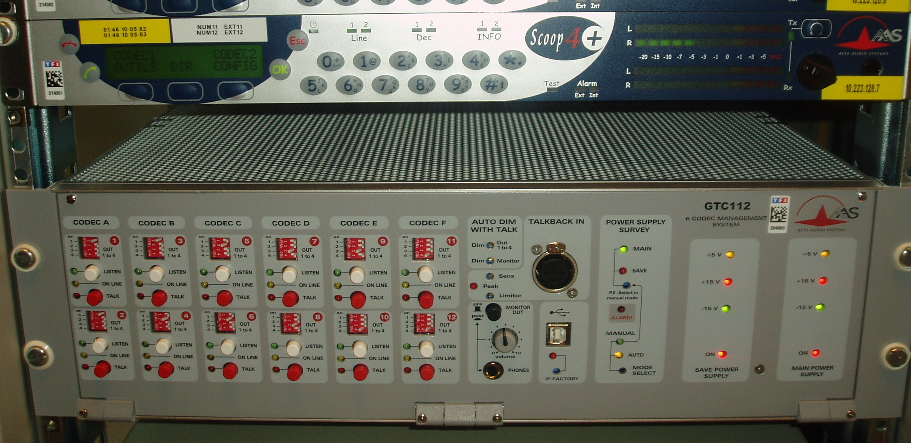
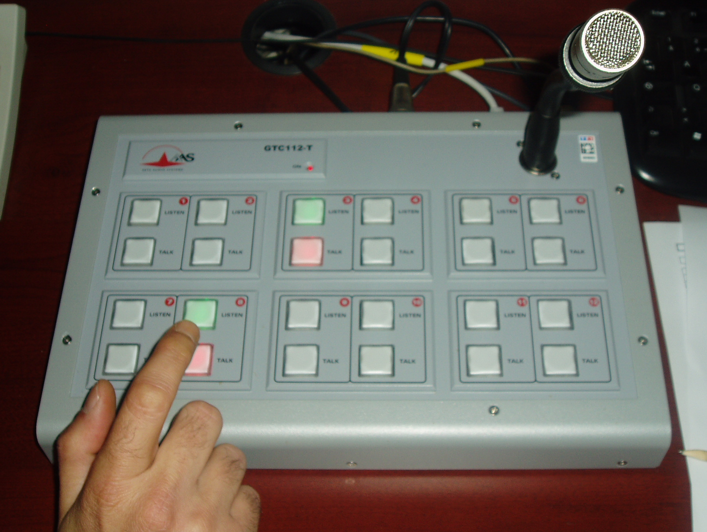
AETA Codecs Control systems
GTC112
Complements codec pool, w/ or w/o Codec Live
Inserted on the audio path to/from the codec
Dedicated and efficient control surface

Slide 18
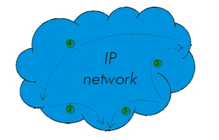
Rackmount codec Scoop 5 S
Radio Broadcasting via IP/Ethernet
based on AETA Codecs
EVENT SITE
IP/Ethernet
STUN server
Portable codec Scoopy+ S
STUDIO
IP/Ethernet

Slide 19
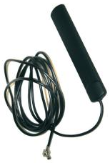
Rackmount codec Scoop 5 S
Radio Broadcasting via G4 / LTE Radio Mobile Connection
based on AETA Codecs
EVENT SITE
Mobile Data connection
G4 / LTE
SIP proxy server
Portable codec Scoopy+ S
STUDIO
IP/Ethernet

Slide 20
Rackmount codec Scoop 5 S
Radio Broadcasting via G4 / LTE Radio Mobile Connection
based on AETA Codecs
EVENT SITE
Mobile Data connection
G4 / LTE
SIP proxy server
Portable codec Scoopy+ S
Mobile Data connection
G4 / LTE
STUDIO

Slide 21
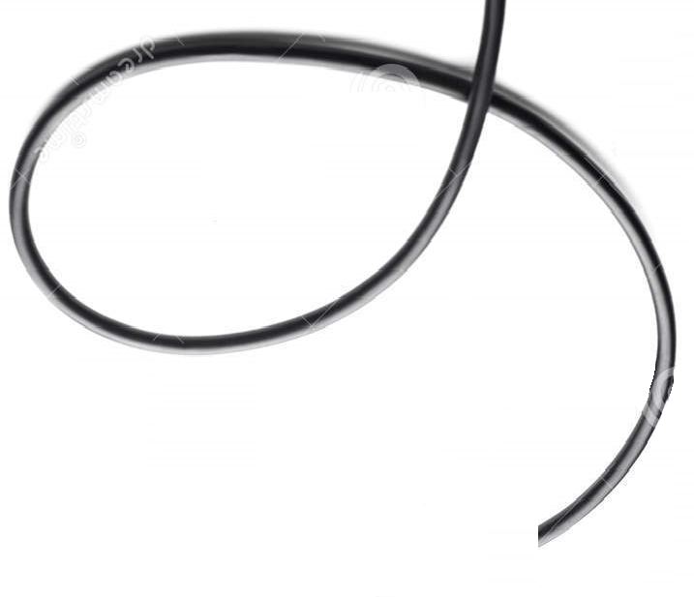
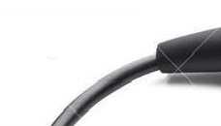
Rackmount codec Scoop 5 S
Reportages and interview via GSM network
(HD Voice two-ways transmission)
EVENT SITE
HD Voice
G2 / G3
Portable codec Scoopy+ S
Mobile network
G2 / G3
STUDIO
HD Voice
G2 / G3

Slide 22
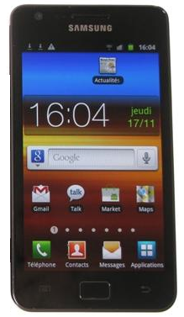
Rackmount codec Scoop 5 S
Reportages and interview via G4 / LTE Radio Mobile Connection
using mobile devices (i-pnones, smartphones, etc.)
EVENT SITE
HD Voice
G2 / G3
Any smartphone supporting HD Voice
Mobile network
G2 / G3
STUDIO
HD Voice
G2 / G3

Slide 23
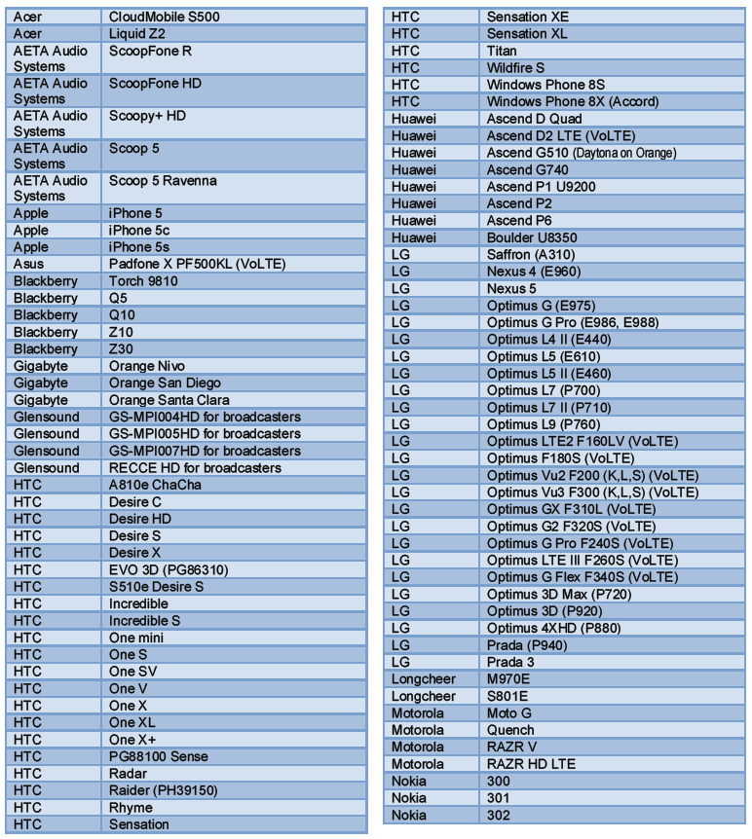
List of devices supporting HD Voice

Slide 24
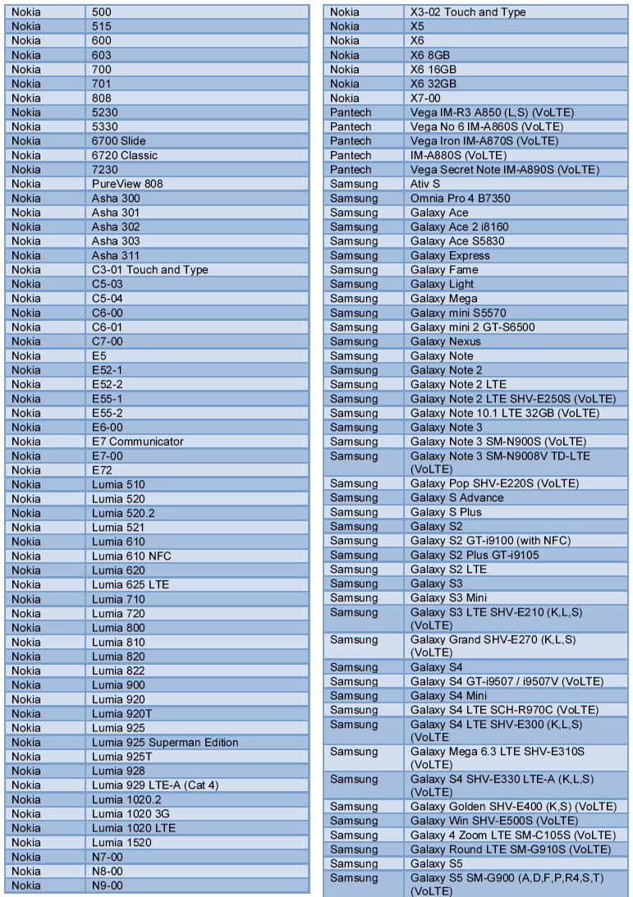
List of devices supporting HD Voice

Slide 25
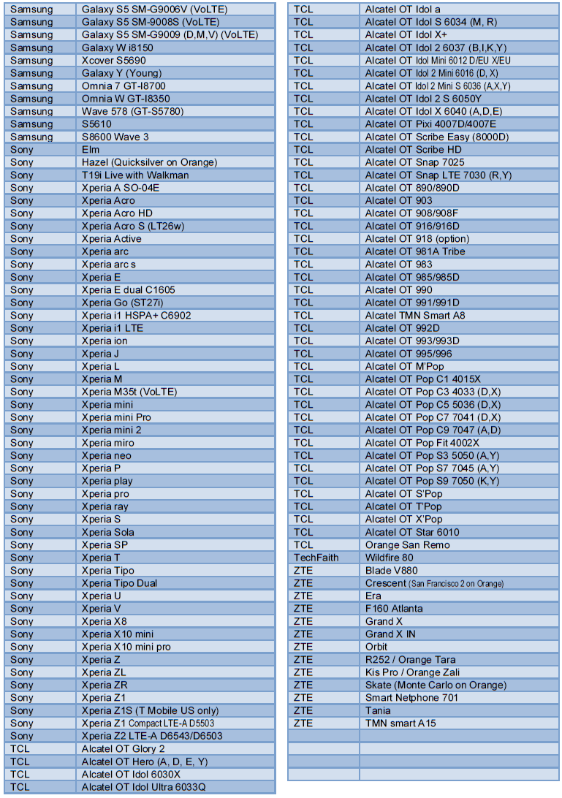
List of devices supporting HD Voice

Slide 26
THANK YOU!

